Slide 1

SPCT301
E-commerce Site Factory with SharePoint, FAST, Commerce Server
Denis Heliszkowski
WE Solution Architect
Ivo Ramos
Solutions Architect

Slide 2
Microsoft Confidential

Slide 3

Who are we?
Denis Heliszkowski
WE Solution Architect
denish@microsoft.com
WE CTO Team

Slide 4

Who are we?
Ivo Ramos
Solutions Architect
ivor@microsoft.com
Microsoft Services Team
Portugal

Slide 5
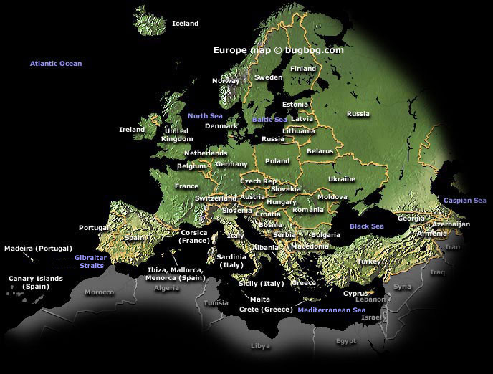
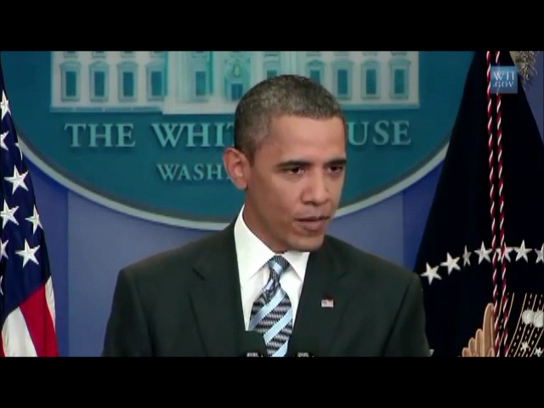

Portugal is huge and famous
Obama talks about us…

Slide 6

Session Objectives and Takeaways
E-Commerce Site Factory Architecture
Challenges and
Approaches
Session Objective(s):
E-Commerce Site Factory Architecture
Solution Challenges
Discuss Different Approaches

Slide 7

Our customer was asking
Unified
Shopping
Basket
Unified
Checkout
Integrate
LOB
Systems
Provision
Malls
Easy
Single
Sign-On
Monitor
Solution
Minimize
Dev
Effort
Call Center
Support
Speed

Slide 8













So let’s install Microsoft E-Commerce.MSI…
Set Of Products
Not a Solution
You’ve better be Ethan Hunt...

Slide 9
E-Commerce Site Factory Architecture
Session Objective(s):
E-Commerce Site Factory Architecture
Solution Challenges
Discuss Different Approaches

Slide 10

Context Diagram
Call Center
Marketplace
Factory
Web SSO
System
Picking And
Shipping
Payment Systems
DWarehouse System
ERP System
Email / SMS Gateway
Routes and Delivery
Loyalty System

Slide 11
Logical Architecture
Presentation Services
Cross Cutting Services
Commerce Services
Integration Layer
Picking And
Shipping
Business Services
Integration Layer
Data Access Services
Search Services
Call Center
Analytical Databases
Media Services
Relational Databases
Reporting
Services
Web SSO
System
Email / SMS Gateway
Routes and Delivery
ERP System
Payment Systems
Loyalty System
DWarehouse System

Slide 12





Technology Stack
Integration Layer
Picking And
Shipping
Data Access Services
Media Services
ADFS 2.0
Email / SMS Gateway
Routes and Delivery
ERP System
Payment Systems
Loyalty System
DWarehouse System

Slide 13
Challenges and
Approaches
Session Objective(s):
E-Commerce Site Factory Architecture
Solution Challenges
Discuss Different Approaches

Slide 14
#1 - Catalog and Campaign Management
Presentation Services
Cross Cutting Services
Commerce Services
Integration Layer
Picking And
Shipping
Business Services
Integration Layer
Data Access Services
Search Services
Call Center
Analytical Databases
Media Services
Relational Databases
Reporting
Services
Web SSO
System
Email / SMS Gateway
Routes and Delivery
ERP System
Payment Systems
Loyalty System
DWarehouse System

Slide 15

Catalog and Campaign Management
Multi
Currency
Physical
Stores
Virtual
Stores
Sales
Areas
Multi
Language
ERP
Data
Synch

Slide 16
#2 - Data Services
Presentation Services
Cross Cutting Services
Commerce Services
Integration Layer
Picking And
Shipping
Business Services
Integration Layer
Data Access Services
Search Services
Call Center
Analytical Databases
Media Services
Relational Databases
Reporting
Services
Web SSO
System
Email / SMS Gateway
Routes and Delivery
ERP System
Payment Systems
Loyalty System
DWarehouse System

Slide 17

Data Services
Plug-in New Systems
IoC
Pattern
Data
Mapper
Pattern
External Systems as Service

Slide 18

Systems Abstraction Layer
IDataMapper
GetAll
GetByCriteria
GetById
GetCount
Add
Delete
Save
IsInTransaction
IsDirty
BeginTransaction
Commit
Rollback
IDataContext
GetAll
GetByCriteria
GetByKey
GetCount
Create
Update
Delete
Unity Application Block
SIBSPayment DataContext
SIBSPayment DataMapper
Payment Systems
1
Create
Instance
Catalog
Business
Services
Commerce
Server
Injects Reference
Commerce DataContext
Commerce DataMapper
Creates Reference
3
4
Calls Concrete Mapper throught public interface
Creates Reference
3
5
DataContext Resolution
Commerce Cloud Services
Unity Config
Cloud Commerce DataContext
Cloud Commerce DataMapper
2
Calls Concrete Mapper throught public interface
5

Slide 19
#3 - Web Single Sign-On
Presentation Services
Cross Cutting Services
Commerce Services
Integration Layer
Picking And
Shipping
Integration Layer
Business Services
Data Access Services
Search Services
Call Center
Analytical Databases
Media Services
Relational Databases
Reporting
Services
Web SSO
System
Email / SMS Gateway
Routes and Delivery
ERP System
Payment Systems
Loyalty System
DWarehouse System

Slide 20

Web Single Sign-On
Silent
Login
Forms
Based
Auth
Claims
Claims
Based
Auth
User
Profiles
ADFS
2.0

Slide 21
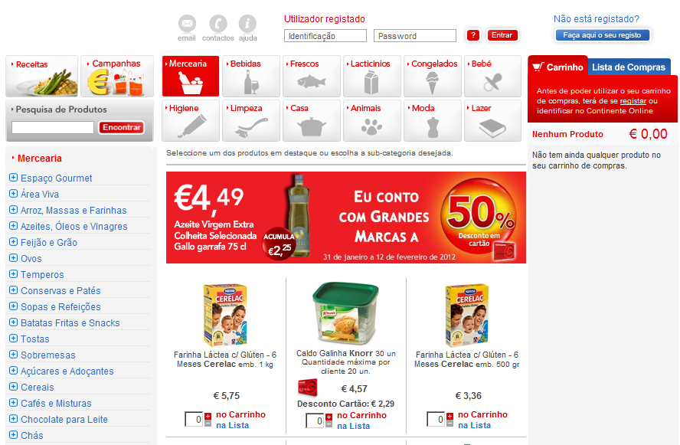
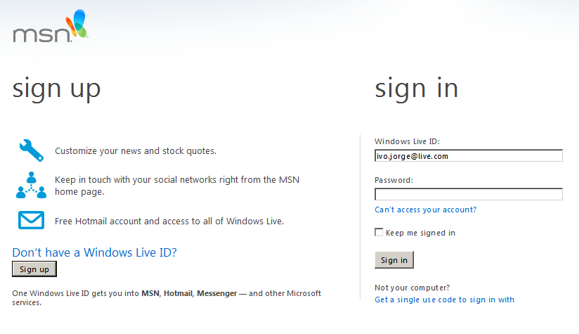
Web Single Sign-On
POST ( http://sts.company.com/silentlogin.aspx)
2
www.marketplace1.com
wreply= http://www.marketplace1.com
FBA
6
4
Auth Token with Claims
1
Authenticates
Build AD
Stored Claims
Sign-In
Claims
SilentLogin.aspx
User Id
Marketplace 1
Email
intranet.marketplace1.com
Identity Provider
Security Token Service
(IP-STS)
CS Profiles
CBA
Password
IsAuthor
3
First Name
Likes Comics
IsAuthor
Likes Comics
Feth Auth
Cookie
www.marketplace2.com
5
Gets Additional
Claims For Commerce
Profiles Store
7
Active Directory
Marketplace 2
User Id
CS Profiles
intranet.marketplace2.com
Email
Password
IsProducer
First Name
Likes RedWine

Slide 22
Web Single Sign-On
www.marketplace1.com
FBA
3
Register
1
Creates
User
Marketplace 1
Identity Provider
Security Token Service
(IP-STS)
CS Profiles
4
2
IsAuthor
Add
Custom Attributes
Checks
Existing User
Likes Comics
www.marketplace2.com
Active Directory
Marketplace 2
User Id
CS Profiles
intranet.marketplace2.com
Email
Password
IsProducer
First Name
Likes RedWine

Slide 23
#4 - Search Services
Presentation Services
Cross Cutting Services
Commerce Services
Integration Layer
Picking And
Shipping
Business Services
Integration Layer
Data Access Services
Search Services
Call Center
Analytical Databases
Media Services
Relational Databases
Reporting
Services
Web SSO
System
Email / SMS Gateway
Routes and Delivery
ERP System
Payment Systems
Loyalty System
DWarehouse System

Slide 24

Search Services
Crawling
Perf
Search
Driven
Nav
Catalog Data and
Rich Content
Light
User
Interface
Extensible
Realtime
Data
Challenge

Slide 25


Search Driven Marketplace
Product
Catalog
FAST For Sharepoint
Feed
Pages
Crawl Pages
Custom
Pipeline
FAST Web
Crawler
Query
Matching
Search
Authorization
Crawling Pages
Product
Rich Content
Read
Content
Add Content
To Index
FAST
Content API
Query
Processing
Monitoring
Administration
Indexing
Catalog Data
Query Object Model
Admin Object Model
Search Services
Query
Services
Metadata
Services
JSON
RunTime Query
Support
Design Time
Support
Presentation Services
Query Web Part
Search Results Web Part
Refiners Web Part
Paging Web Part

Slide 26
In Review: Session Objectives and Takeaways
E-Commerce Site Factory Architecture
Challenges and
Approaches
Session Objective(s):
E-Commerce Site Factory Architecture
Solution Challenges
Discuss Different Approaches

Slide 27
Related Content
Breakout Sessions Chalk Talks
SP204 Deploying FAST Search for SharePoint on an Enterprise Scale at Boeing and Chevron
SP305 Making the Search User Experience shine in SharePoint 2010 (FAST Search)
SP306 Beyond the Basics: An Advanced Conversation on FAST Search for SharePoint 2010
SP319 FAST Search: Overcoming Customer Security Concerns and Optimizing the Search Experience with SharePoint Enterprise Edition
MSDY308 AX 2012 for Retail – Investments in Retail Headquarters and Online Services
AZR203 Real world examples: Unlocking opportunities through the Data Market on Windows Azure Marketplace
Hands-on
Labs
SPHOL305 FAST Search for SharePoint Server 2010: Introduction
Additional
Info

Slide 28


Please Complete An Evaluation Form Your input is important!
Multiple ways to access Online Evaluation Forms:
CommNet stations located throughout conference venues
Via a Windows mobile device
Via the CommNet Windows Phone Evaluation and Session Scheduling application
From any wired or wireless connection to https://www.MyTechReady.com
1.
2.
3.
4.
For more information please refer to your Pocket Guide
Speaker – Click Here to Launch Video

Slide 29

© 2012 Microsoft Corporation. All rights reserved. Microsoft, Windows, Windows Vista and other product names are or may be registered trademarks and/or trademarks in the U.S. and/or other countries.
The information herein is for informational purposes only and represents the current view of Microsoft Corporation as of the date of this presentation. Because Microsoft must respond to changing market conditions, it should not be interpreted to be a commitment on the part of Microsoft, and Microsoft cannot guarantee the accuracy of any information provided after the date of this presentation. MICROSOFT MAKES NO WARRANTIES, EXPRESS, IMPLIED OR STATUTORY, AS TO THE INFORMATION IN THIS PRESENTATION.

Slide 30
Integration Layer
Presentation Services
Cross Cutting Services
Commerce Services
Integration Layer
Picking And
Shipping
Business Services
Integration Layer
Data Access Services
Search Services
Call Center
Analytical Databases
Media Services
Relational Databases
Reporting
Services
Web SSO
System
Email / SMS Gateway
Routes and Delivery
ERP System
Payment Systems
Loyalty System
DWarehouse System

Slide 31




Campaign and Catalog Import Processes
Erp System
Marketplace
1
6
Manage Catalog Data
Data Validation
Manage Marketing Data
Data Enrichment
5
Export Product Changes
Export Price Changes
Export Stock Changes
Import Product Catalog
Export Discounts Changes
Import Stock Catalog
Import Discounts
2
Staging Zone
3
4
Gather Product and
Price Changes
Translation
Generate Product
Catalog Message
Data Import
Gather Stock Changes
Generate Stock
Catalog Message
Gather Discounts
Changes
Generate Discounts
Message

Slide 32
Order Lifecycle Management
Commerce Services
Call Center
(CRM)
1
Submit Order
Business Services Broker
Picking and Shipping
2
Workflow
Initialization
Workflow
3
Order
Serialization
EAI
Mobile Picking
Synchronize
Order
Synchronize
Order
4
4

Slide 33
Order Lifecycle Management
Change To Cancelled
Rejected
5
Commerce Services
Call Center
(CRM)
2
Cancel Order
2
Start Preparing Shipment
Picking and Shipping
Business Services Broker
3
Validate
Workflow Rules
Change To Preparation
Accepted
5
Change Order
To Preparation
4
Get
Picking
Lists
Workflow
1
Mobile Picking
Order Update
Serialization
6
EAI
Synchronize
Order
7
Order Update
Serialization
7

Slide 34
Presentation Services
Presentation Services
Cross Cutting Services
Commerce Services
Integration Layer
Picking And
Shipping
Business Services
Integration Layer
Data Access Services
Search Services
Call Center
Analytical Databases
Media Services
Relational Databases
Reporting
Services
Web SSO
System
Email / SMS Gateway
Routes and Delivery
ERP System
Payment Systems
Loyalty System
DWarehouse System

Slide 35

Presentation Services
Extensible
Light
Adaptive
UX
Template based

Slide 36

Lightweight User Interface
Browser
Invoke Web Service To Get Data From Server
Placeholder
Refresh
Callback Function To Process Data
JSON
HTML Template
Build HTML based on template
Browser
Refresh
HTML Template

Slide 37
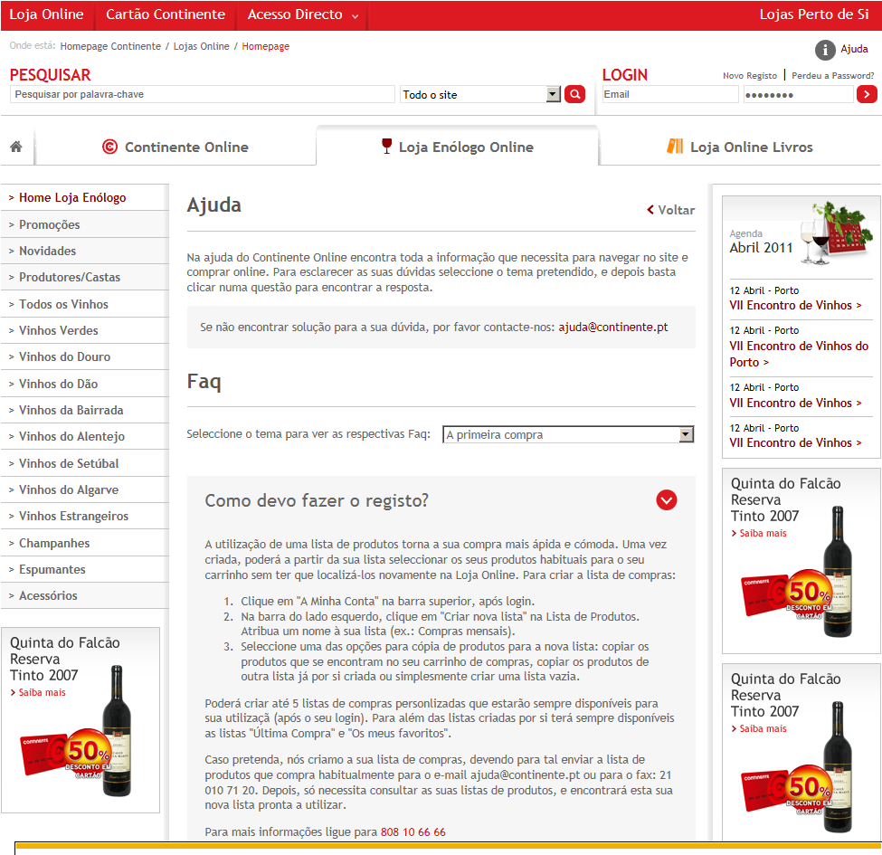
Performance Concerns: Caching
Browsing
Page Output Cache
VaryByParam ( Store )
Caching
Profiles
Editing

Slide 38
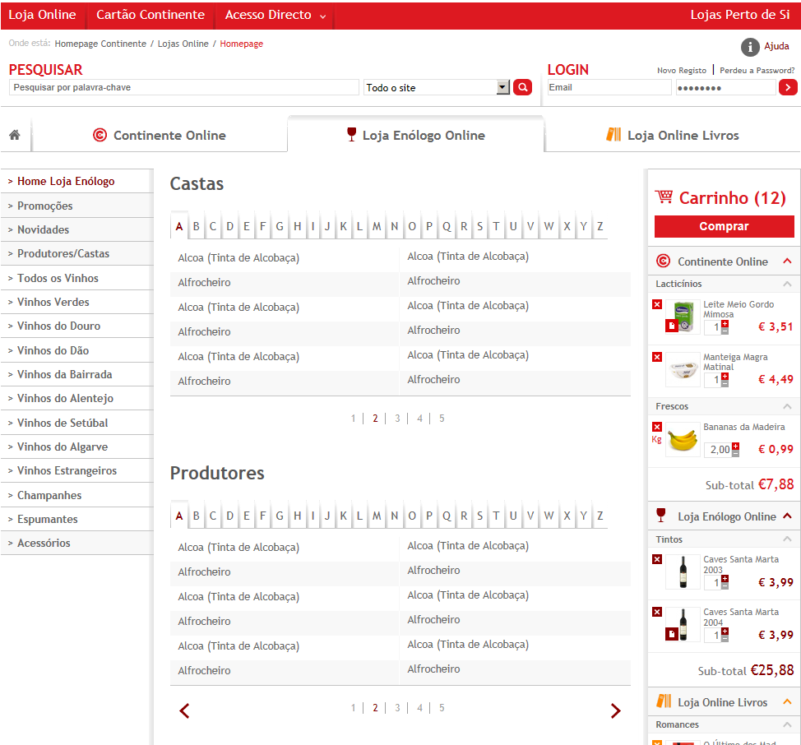
Performance Concerns: Caching
Page Output Cache
with Post-Cache
Substitution
VaryByParam ( Store )
Dynamic
Content Replacement

Slide 39
Performance Concerns: Caching
Interception
Services Layer
Interception
Caching Configuration
Business Layer
Services
Component
Method
Services
CatalogServices
GetCategories
Interception
App Fabric Client
Services
MarketingServices
GetDiscounts
App Fabric Server
Data Layer
Services
AccountServices
GetUserData
Business
BasketManager
GetData
Object Caching

Slide 40
Call Center
Presentation Services
Cross Cutting Services
Commerce Services
Integration Layer
Picking And
Shipping
Business Services
Integration Layer
Data Access Services
Search Services
Call Center
Analytical Databases
Media Services
Relational Databases
Reporting
Services
Web SSO
System
Email / SMS Gateway
Routes and Delivery
ERP System
Payment Systems
Loyalty System
DWarehouse System

Slide 41


Marketplace Call Center Support
Web Chat
Instant
Messaging
Customer Relationship
Management
Communicator
Customers
Pools
Orders
Invoices
Cases
Refunds

Slide 42
Sharepoint Solution Structure
Branding
Definitions
Provision
Search
Services
Web Parts
Images
Configs
Admin Controls
Crawled Pages
JSON Services
Web Parts
Scripts
Site Defs
Admin Pages
Styles
Ribbon Extensions
Layouts

